Slide 1

Deep Picker: Enhancing Material Analysis through 1D Spectra
This presentation details adapting the Deep Picker model for material detection using 1D spectra, covering challenges, achievements, and future prospects.
BH
Presenter ：Boyang He
All the modifications are based on the paper titled: DEEP picker is a deep neural network for accurate deconvolution of complex two-dimensional NMR spectra

Slide 2

Project Background
Company Need
Deep Picker Model
1D spectra analysis of substance amplitude in varying concentrations.
Reviewed literature and found a key paper on NMR spectroscopy.
Adaptation Required
Due to the short timeframe, I developed a POC based on the research paper, adapting its methodology to our spectral data.
Notes:
Flow 从 company needs 不是predicting 用characterize 从公司需求 搜了论文 找到了文章 虽然他是应用在nmr上 但可以拓展
基于短时间的需求 poc proof of concept
精简，两行或三行

Slide 3
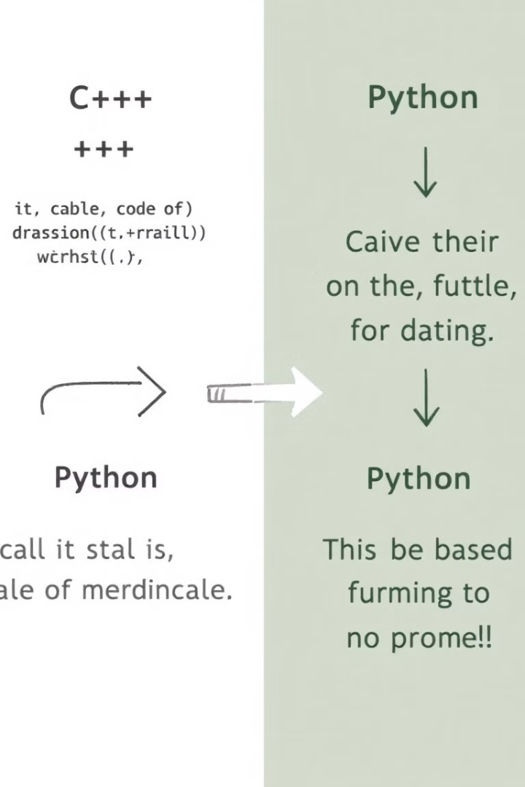
Model Reproduction and Modification
Environment Setup and language transformation
1
Reproduced C++ model using cmake, then modified in Python. Overcame compatibility issues using Docker for GPU training.
Data preparation
2
Overcame compatibility issues using Docker for GPU training.
Model Architecture
3
Input: Intensity at each point of mixed spectra.
Output:
Classification Layer: Identifies spectral features as either dominant peaks (Class 1) or background points (Class 0).
Regression Layer: Predicts the area of five peaks in the mixed spectra.

Slide 4
Data Simulation and Experimental Design
Design of Experiment (DOE)
Spectrum Synthesis
Dataset Creation
Collaborated with experts to design simulation parameters. Discussed NMR, spectroscopy, liquid chromatography, and gas chromatography applications. Fixed peak positions and widths, varied areas, and used machine learning to predict small intensities.
Fixed peak positions and sigma, varied areas, and added noise. Finalized sigma at 8 and centers at [20, 30, 40, 60, 70] for realistic spectra within [0, 100].
Generated 26,214 training, 6,554 validation, and 7,776 test samples. Trained for 4000 epochs with batch size equal to training data length. Tested area ratios from 100:1 to 1000:1, observing accuracy, MSE, MAE, and R2.

Slide 5
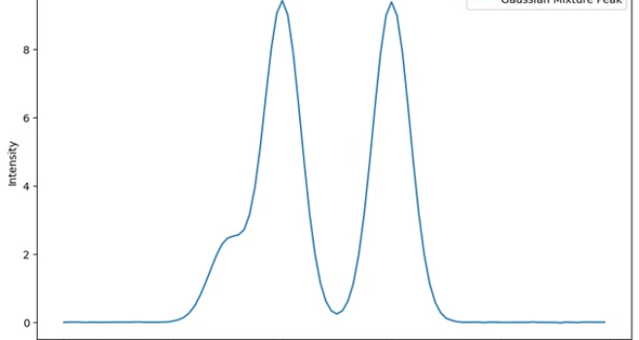
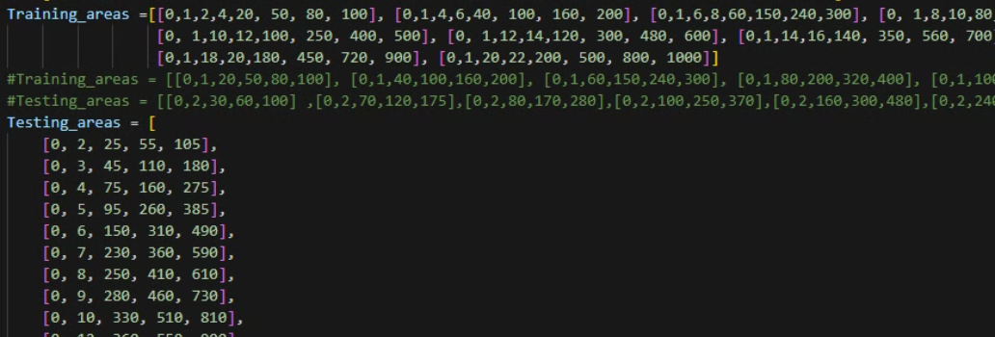
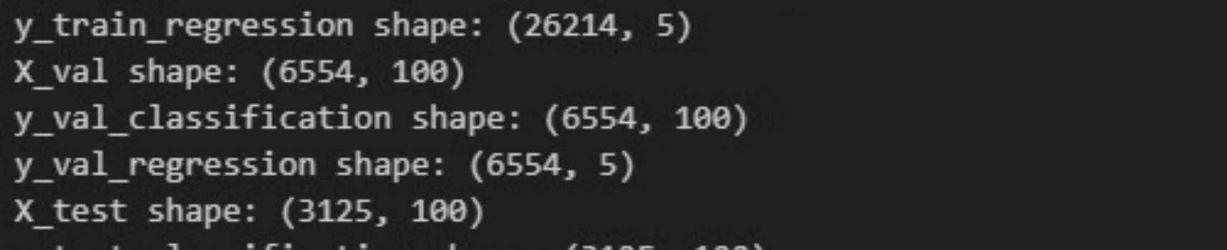
Training Data Overview for Model Development

Slide 6
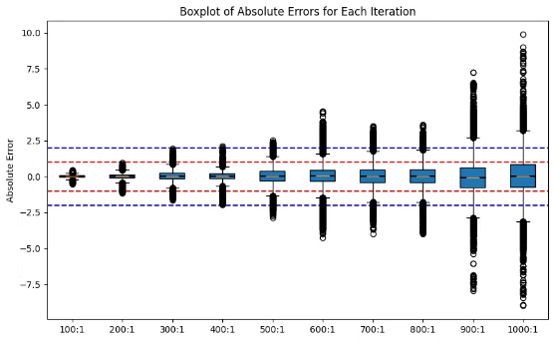
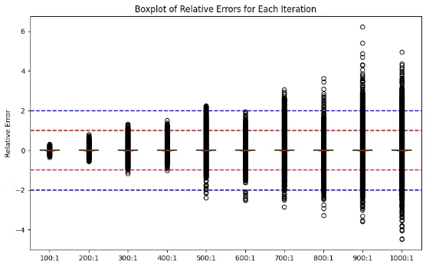
After multiple cross validations, I found that a 600:1 ratio performs well in predicting both small areas (area < 10) and large areas (area > 200), with relative error under 2%.
Model Training and Performance at best Amplitude ratio(600:1)
90%
0.46
Accuracy
MSE
The percentage of correctly classified instances..
Mean Squared Error at optimal performance.
0.99
0.49
R2 Score
MAE
Measures how well the model's predictions match the actual data; ranges from 0 to 1.
Mean Absolute Errorat optimal performance.

Slide 7



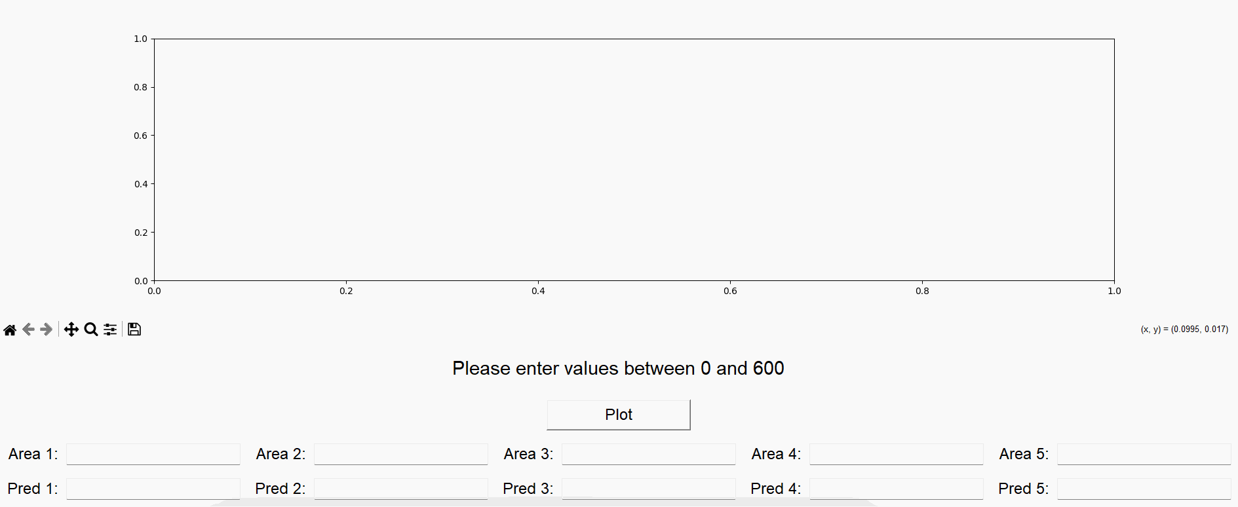
User Interface Integration
Input
Processing
Output
Users enter area values to create spectral graph.
Model predicts based on input data.
Comparison of predicted and original spectral graphs.

Slide 8





Key Learnings
Multithreading
Docker
Used Python's ThreadPoolExecutor for efficient data generation.
Built and configured Docker environment for model training.
Data Analysis
Soft Skills
Mastered spectral data simulation and performance analysis techniques.
Effectively communicated with experts, captured cross-disciplinary requirements, and translated them into technical solutions.
Notes:
Cross-disciplinary
Translation 成我的technical solutions
Clearly communicate stakeholder
Effectively communicated with experts, captured cross-disciplinary requirements, and translated them into technical solutions.

Slide 9



Future Prospects
Peak Location Flexibility
Adapt for different materials
Future goal: extend to 2D spectra.
1
Realistic Noise Simulation
2
Enhance robustness by adding realistic noise.
Continuous Improvement
3
Refine model based on real-world feedback and new data and migrate the UI to a user-friendly HTML interface.
Notes:
将ui 移植到user friendly的 interface
Html形式
精简
可以考虑拓展到二维谱图上
跟一个github link contact email

